Slide 1
S3 Hosting A Static Website
Jacob Johnson
jmjohnson63660@gmail.com
https://www.linkedin.com/in/jacob-m-johnson-198718167/

Slide 2
What Am I Going To Do?
This presentation will demonstrate how to create an S3 bucket and put objects into your bucket
Make objects publicly readable from everywhere over the internet
Configure a static website on your bucket
Access your website

Slide 3
What Is S3?
S3 stands for simple storage service
S3 is for object storage on the web in AWS
Object storage is flat static files meaning no matter who views them they will never change
S3 is broken up into buckets and objects
Buckets are like a file folder for all your objects
Objects are the files inside of buckets
Objects can be stored inside of objects which are stored in a bucket

Slide 4
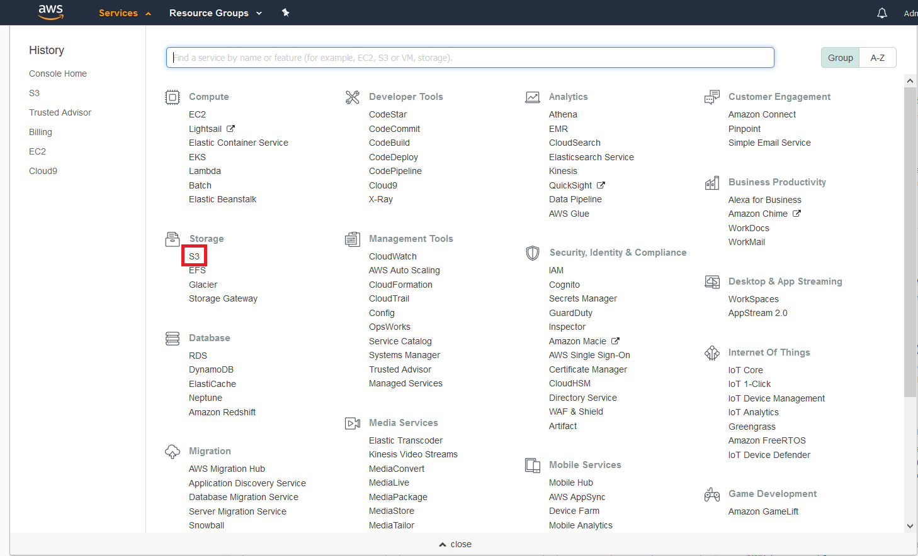
Locating S3 in the console
If you click the services drop down arrow you can locate S3 under storage
Click on it to be directed to the S3 splash screen

Slide 5
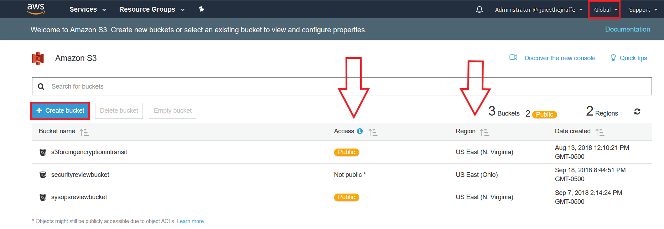
S3 Screen
S3 is a global namespace which means that your buckets names need to be unique
Even though S3 as a whole is global buckets are created in specific regions
Also notice the access, by default no one will have access to your bucket over the internet
Click create a bucket

Slide 6
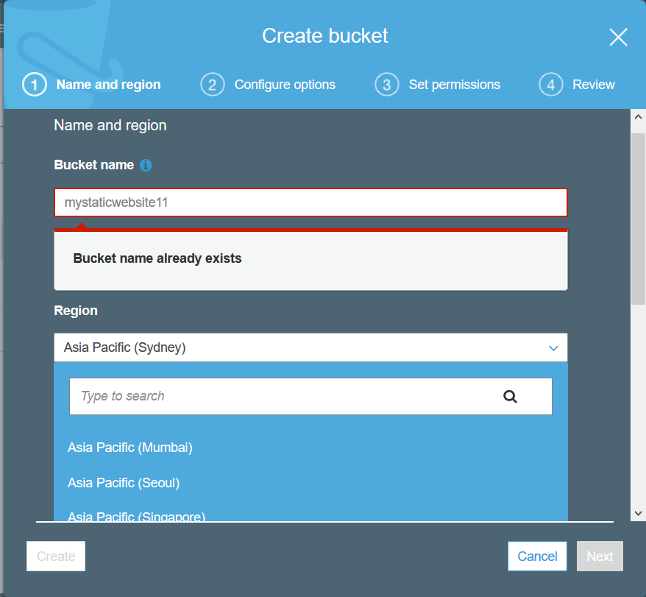
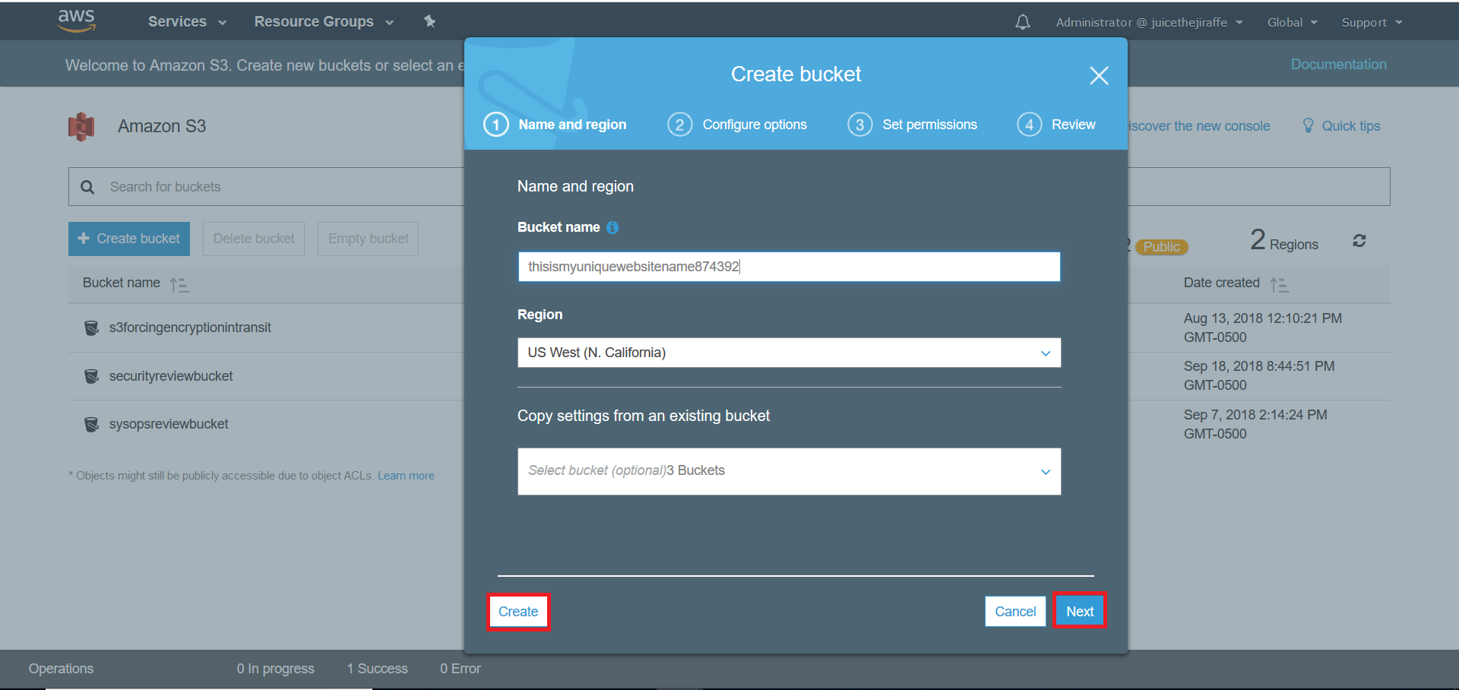
Making A Bucket
The bucket name has to be unique due to the global namespace
The region dropdown box will select where your bucket will be deployed
We could click next and see more options, but it is not needed
Click create to create the bucket

Slide 7
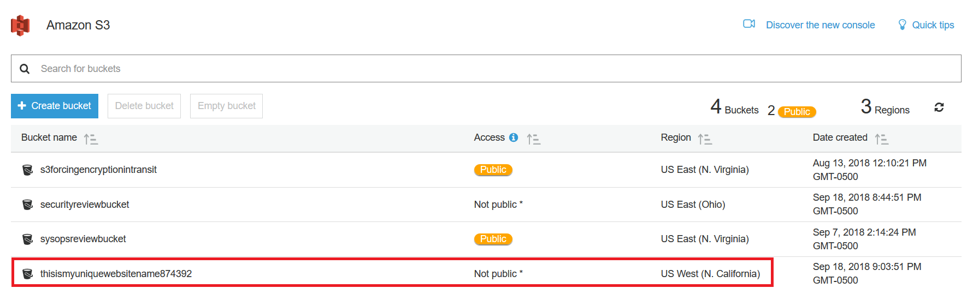
This will now display the new bucket you created in your list
Notice that it is not public and notice how it is in a different region then my other buckets
Because it is global all of your buckets in your account will be displayed in the same place
Click the name of the bucket to get ready to upload a file

Slide 8
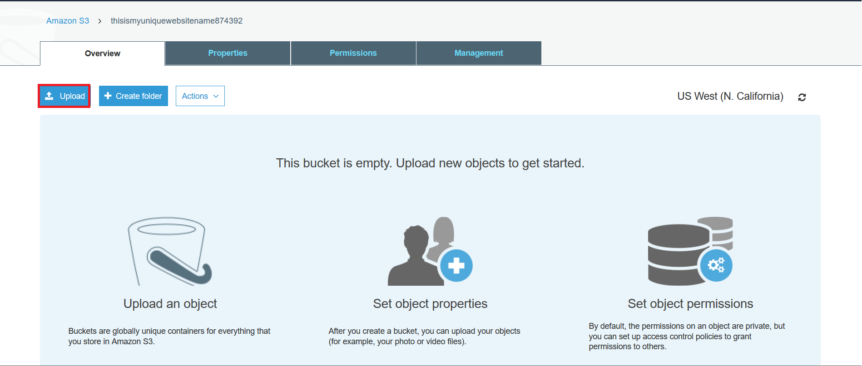
Upload An Object
The splash screen for each bucket will display like so
Every object uploaded in your bucket will be displayed here
We do not have any objects as this is a new bucket
Click the upload button in the upper left hand corner

Slide 9
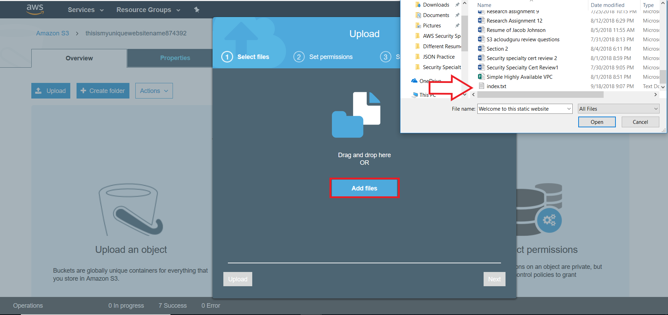
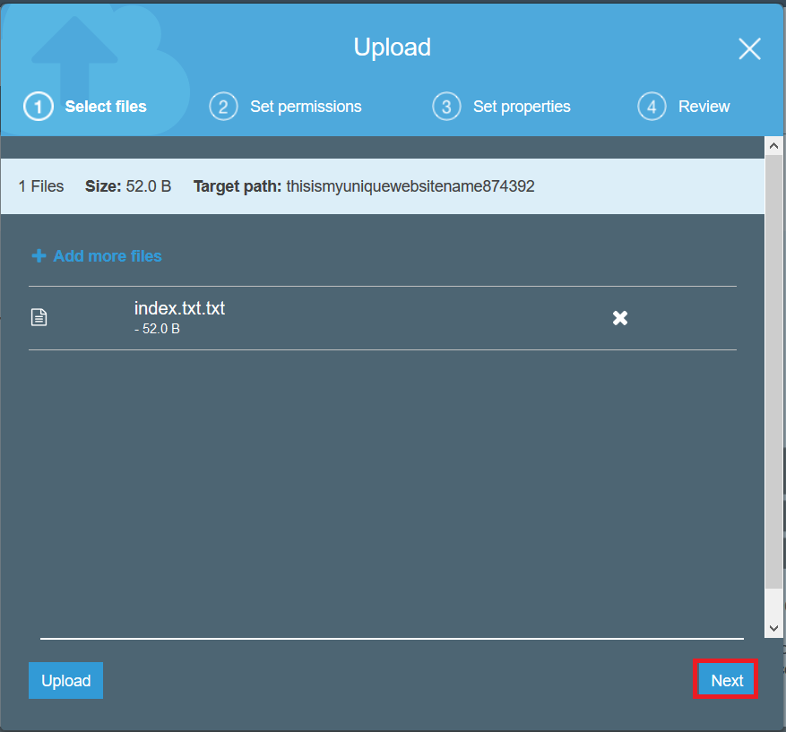
When you click upload it pulls up a screen like this
Click add file and locate the file you want to upload
After you click the file you can either click upload or click next for more options
We are going to click next because we want to change the object access control list to public read access
If you skip this step then you will get an access denied error while trying to access the website over the internet

Slide 10
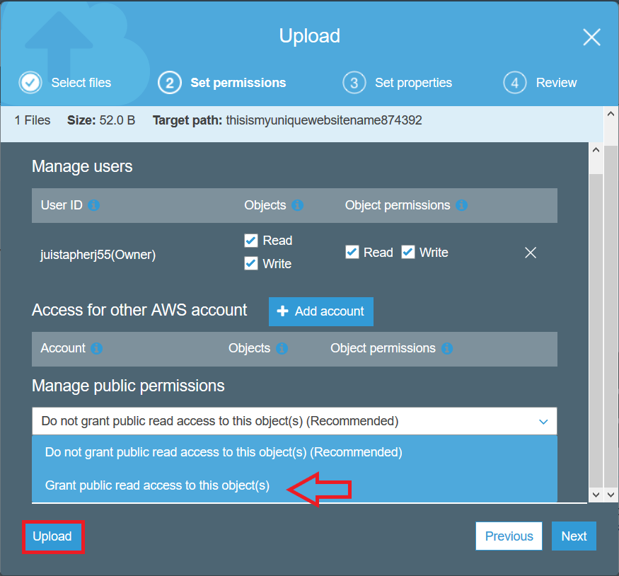
Granting Read Access
We will get a screen like this and here we can set permissions
Click the drop down arrow and select Grant Public Read Access To This Object
We could click next and continue going through options, but this is all we need so we will click upload

Slide 11
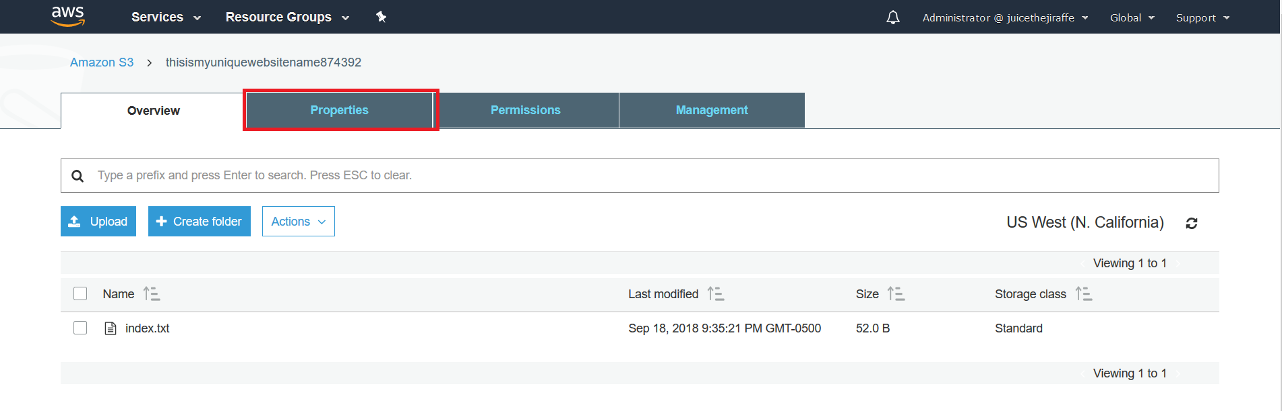
The object will now be uploaded to in your bucket
Now we need to enable static website hosting
Click on properties to find the option

Slide 12
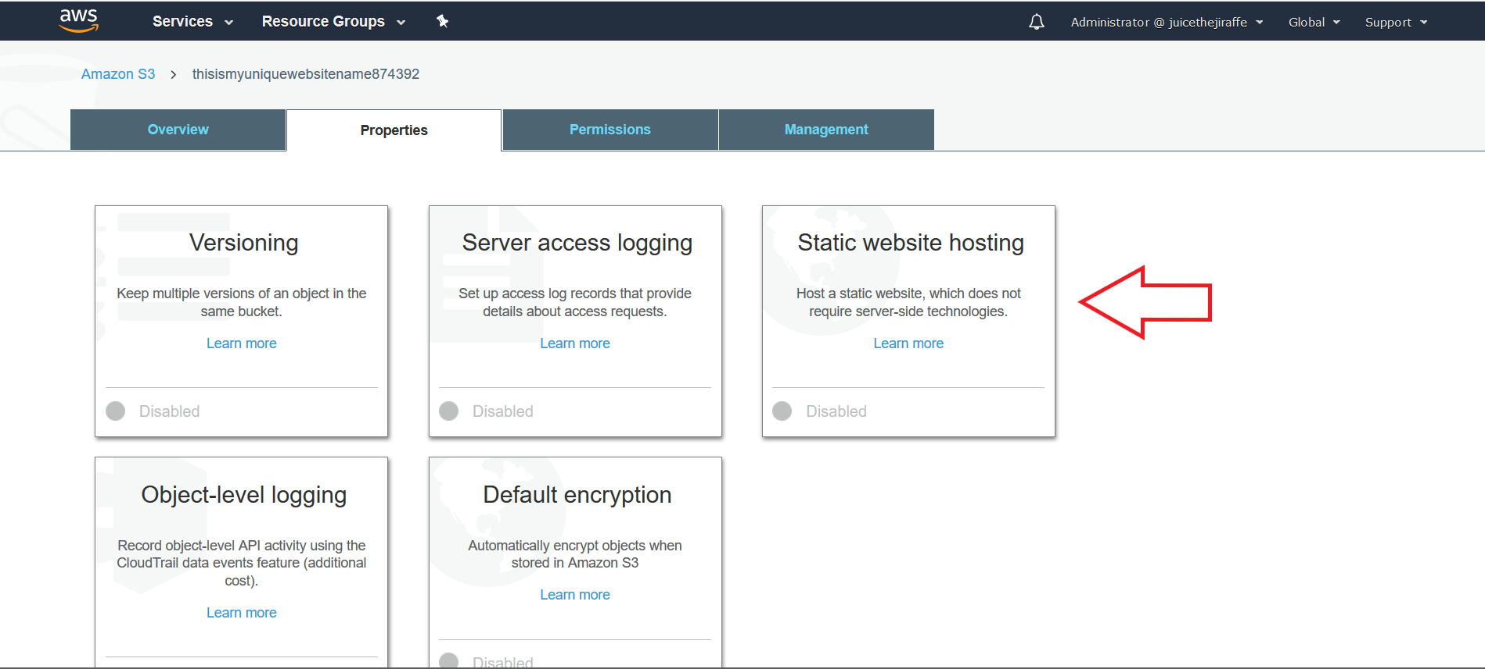
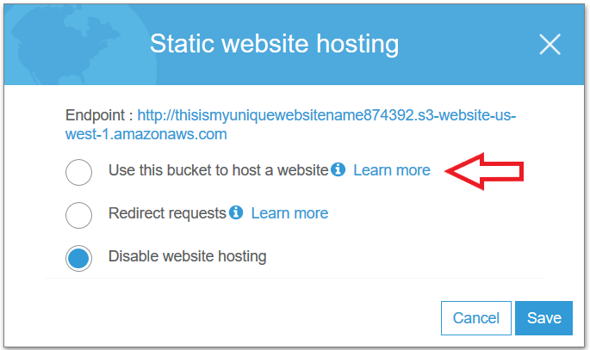
Static Website
The properties tab look like this
Locate static website hosting and click it
It will expand your options
Select Use This Bucket To Host A Website

Slide 13
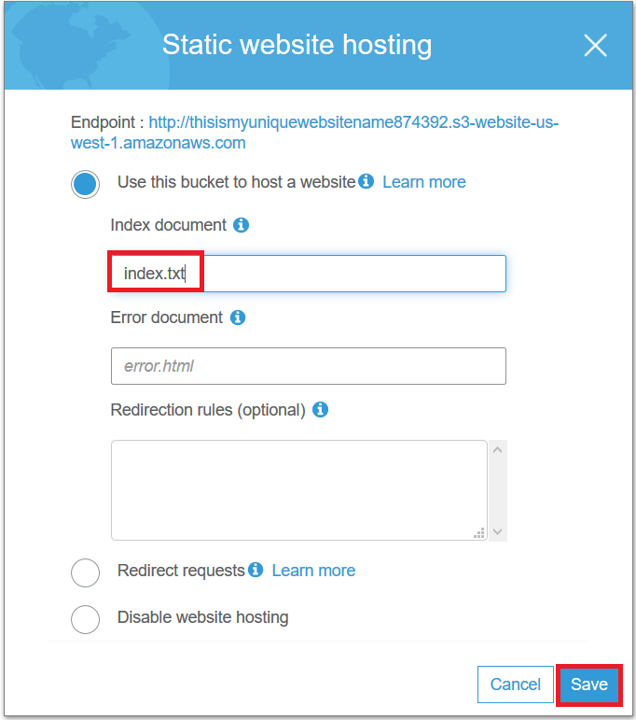
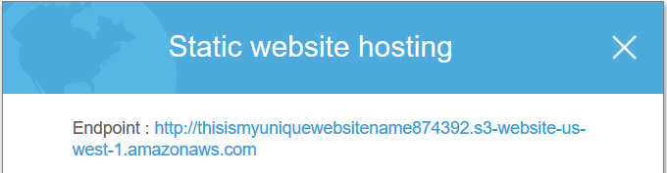
Configuring The Static Website
When you click that option it will expand more options for you
You need to designate the file you want the website to read from in the index document tab and click save
Now we are ready to view are website
Simply click on the endpoint stated in the static website options

Slide 14
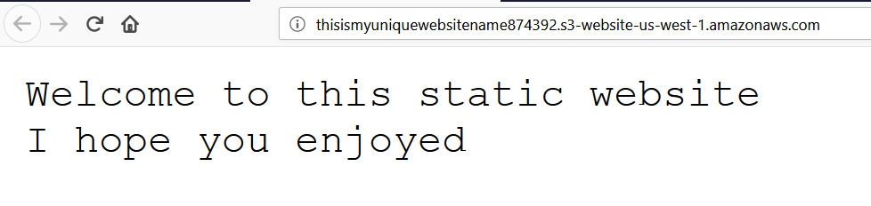

Slide 15
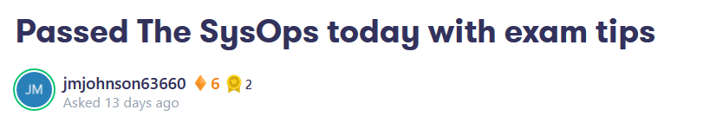
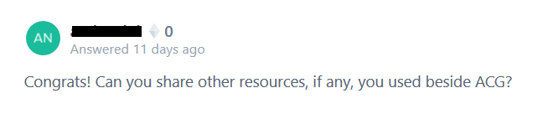
My Real World Example
After finishing the Sys Ops Associate Certification earlier this month I went into the ACloudGuru forums in the SysOps course expressing things I got on my test that was not covered in the course
People liked what I had to say and asked if I had any notes to share
Lets just say I got tired of emailing people my notes

Slide 16
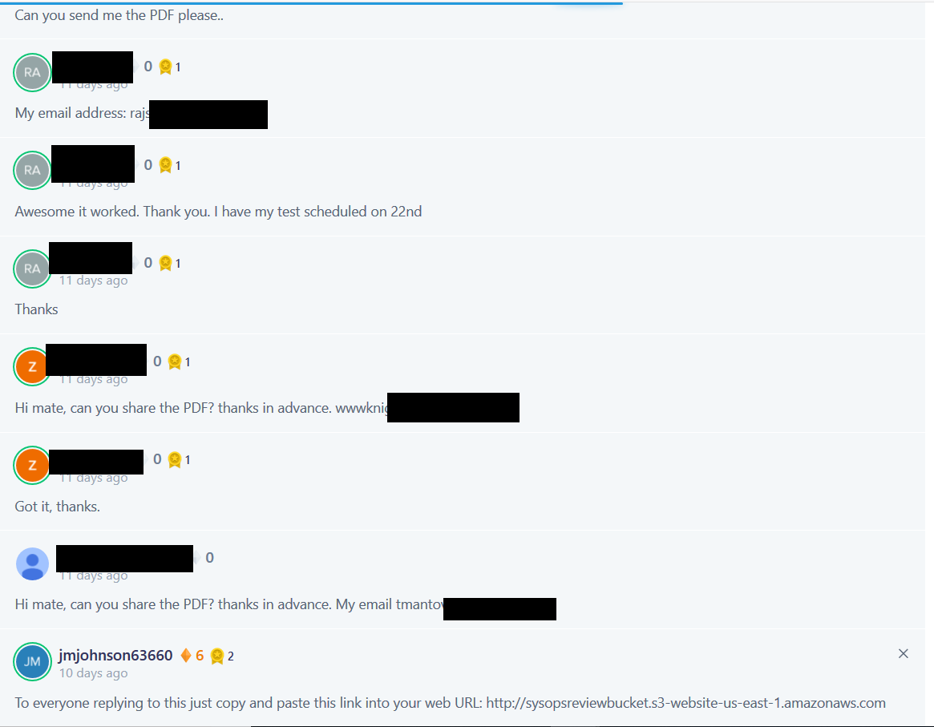
All of these email requests happened within a few hours of posting my opinions and tips. I even got more people asking for my review after I put it in the bucket.

Slide 17
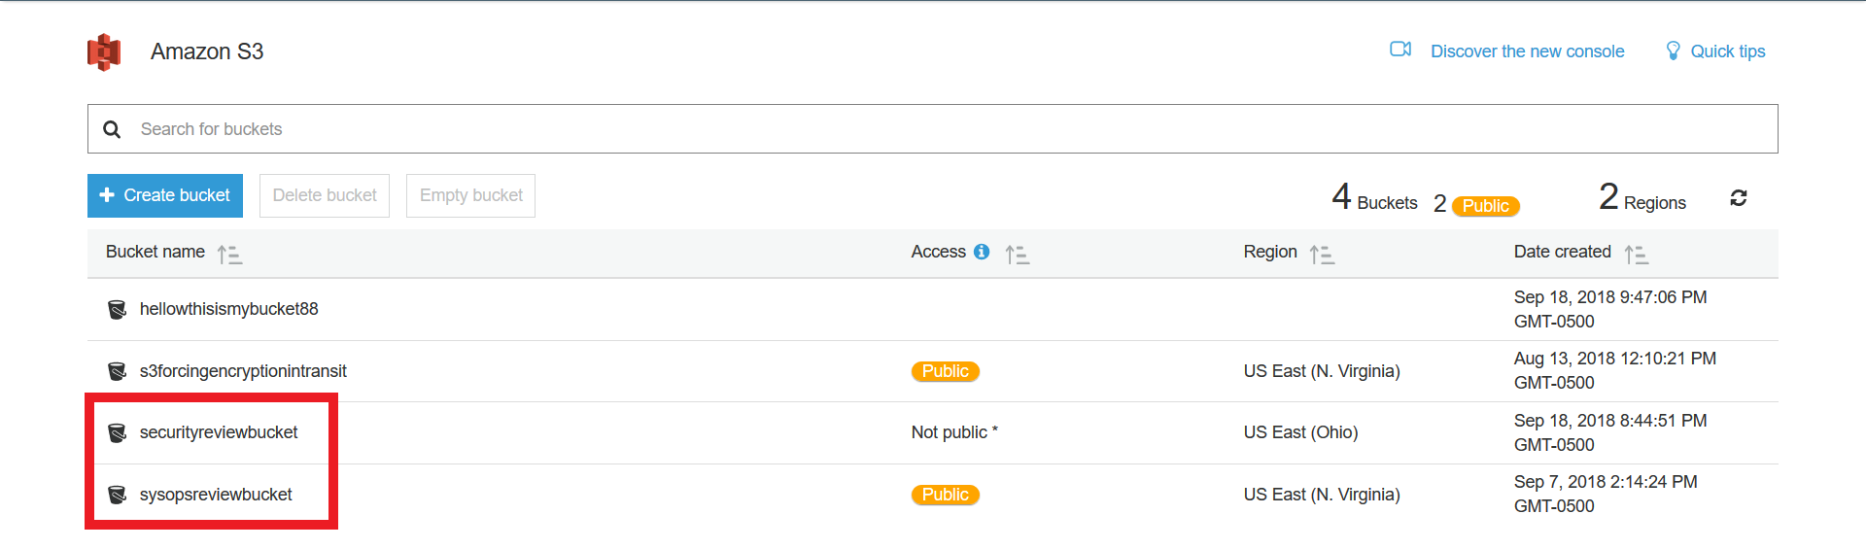
I am planning on taking the security specialty certification in the beginning of October and a plan to do another forum post about my experience. This time I am going to be a little more prepared as I already configured my bucket. I just need to finish my notes!

